Slide 1
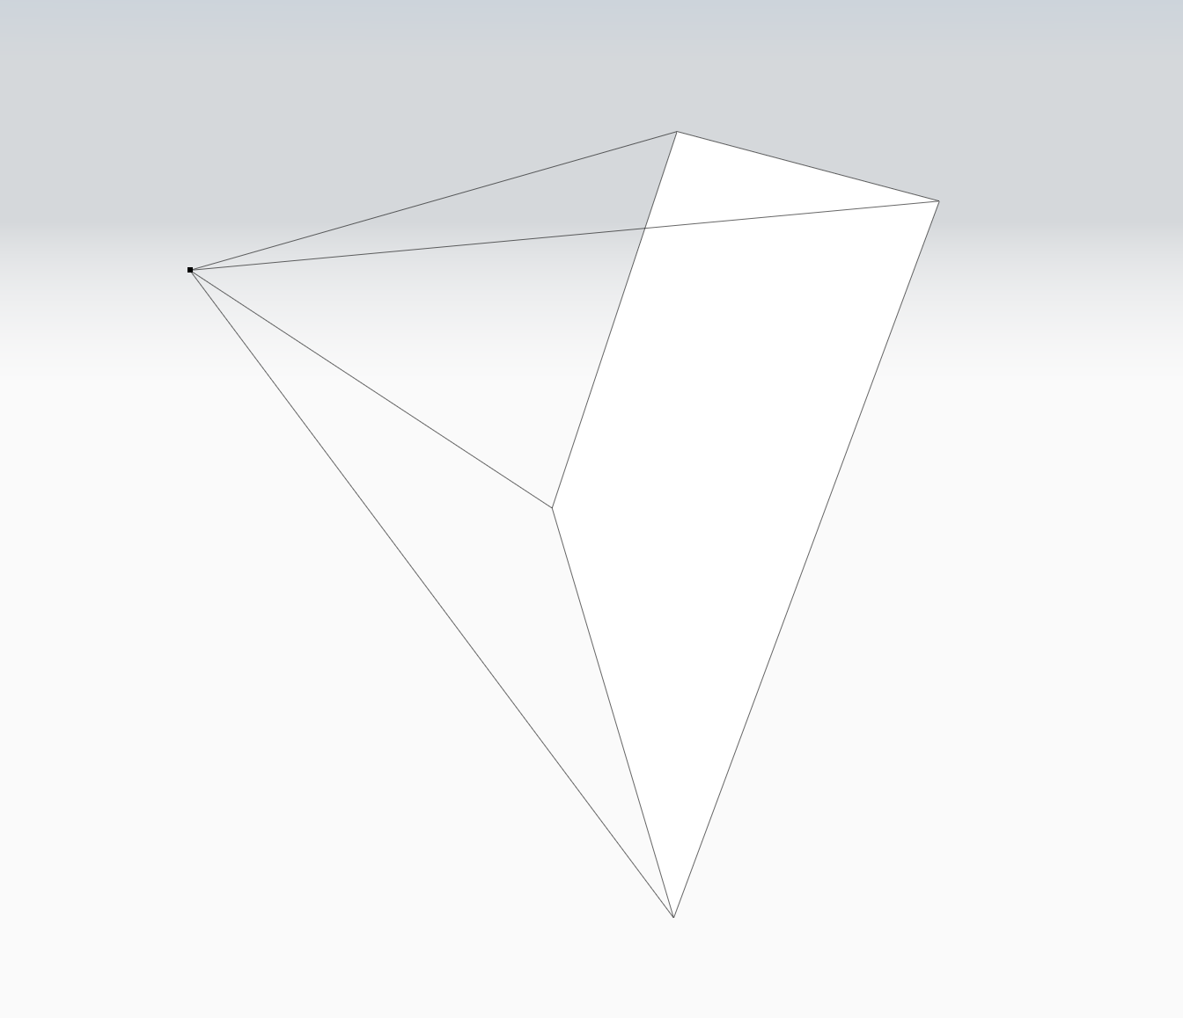
Scene 1
Scene 1

